Slide 1
Data Analysis and Visualisation
Cluster Analysis and Hierarchical Clustering

Slide 2
Clustering Analysis
What is it and why is it important?
Cluster analysis is a set of exploratory techniques (i.e. unsupervised) that searches multivariate data for a structure of “natural” groupings.
Grouping can be achieved through various measures of distances, which are then used to define similarities (or dissimilarities) among the identified groups.
These groupings can provide informal assessments of dimensionality, multivariate outliers and suggest possible hypothesis concerning their associations.
In cluster analysis, grouping of samples or individuals is typically the focus, however grouping of variables is also valued.
Notes:
Cluster analysis is an “unsupervised” technique and makes no assumptions regarding the number of groups or the group structure.

Slide 3
Clustering Analysis
The number of groups (clusters) is arbitrary and there is no “standard” approach in defining these them.
In most practice applications, it relies on the expertise of the researcher on the subject at hand and the purpose of the investigation.
We can also assess the groupings visually with dendrograms and heatmaps.
There are also measures that can be used to assess the overall cluster structure.
The choice of closeness measure will also have an impact.

Slide 4
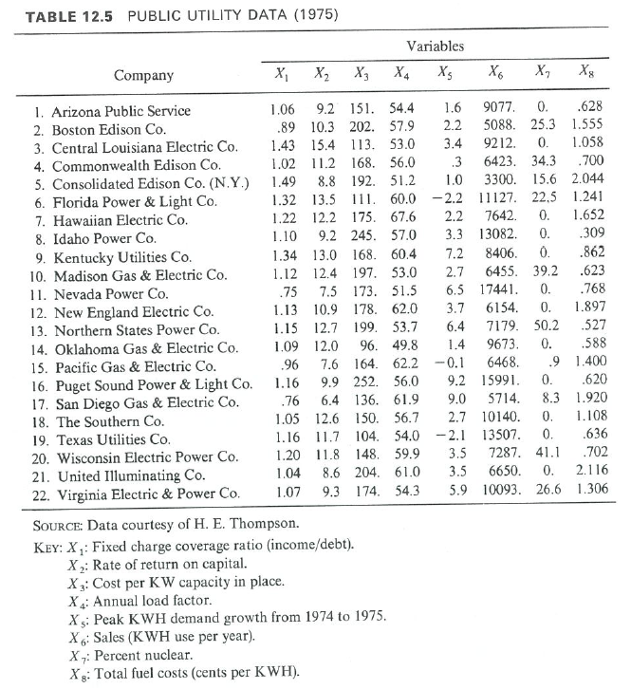
Distance Matrix
Public utility data of 22 U.S. companies (taken from Johnson and Wichern, 1992)

Slide 5
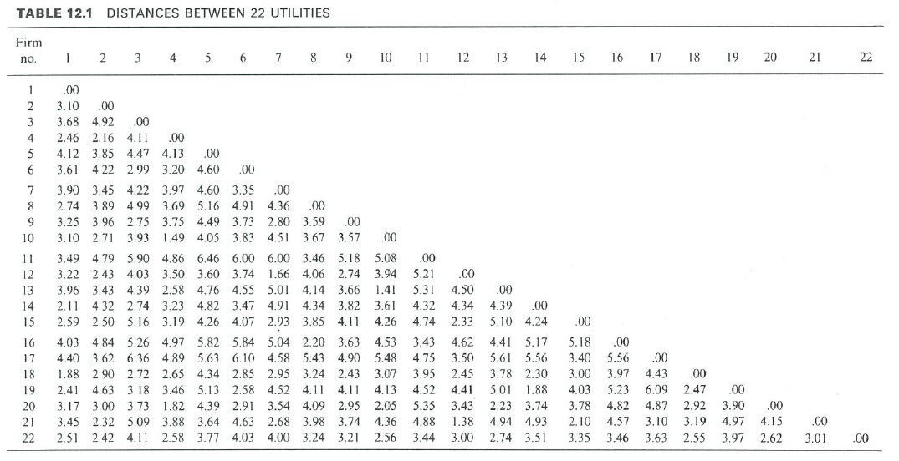
Distance Matrix
Euclidean distance matrix on the standardised data

Slide 6
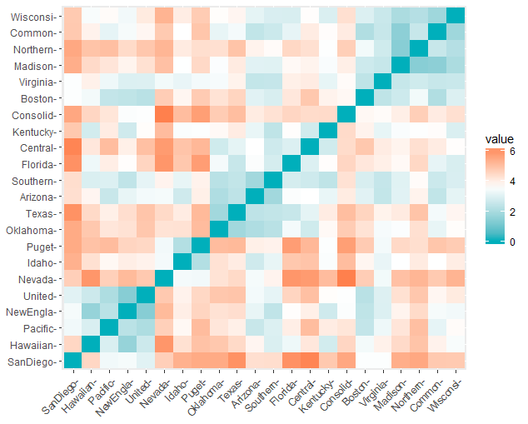
Distance Matrix
Visualisation of distance matrix through shading of classes.

Slide 7
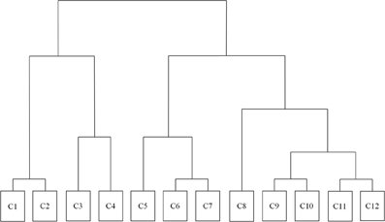
Hierarchical Clustering
Hierarchical clustering (HC) aims to create cluster hierarchy, which is commonly displayed in a tree diagram called dendrogram.
A dendrogram illustrates where
clustering occurred at each step of the
process.
HC can be performed on both the
individuals (samples) and variables.
There are two main types of HC:
Agglomerative HC (also known as Agglomerative Nesting; AGNES)
Divisive HC (also known as Divisive Analysis; DIANA)

Slide 8
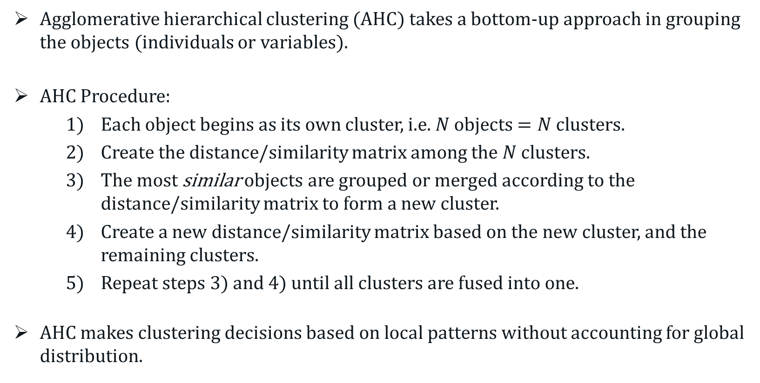
Agglomerative Hierarchical Clustering
Agglomerative hierarchical clustering (AHC) takes a bottom-up approach in grouping the objects (individuals or variables).
AHC Procedure:
Each object begins as its own cluster, i.e. $N$ objects $=N$ clusters.
Create the distance/similarity matrix among the $N$ clusters.
The most similar objects are grouped or merged according to the distance/similarity matrix to form a new cluster.
Create a new distance/similarity matrix based on the new cluster, and the remaining clusters.
Repeat steps 3) and 4) until all clusters are fused into one.
AHC makes clustering decisions based on local patterns without accounting for global distribution.

Slide 9
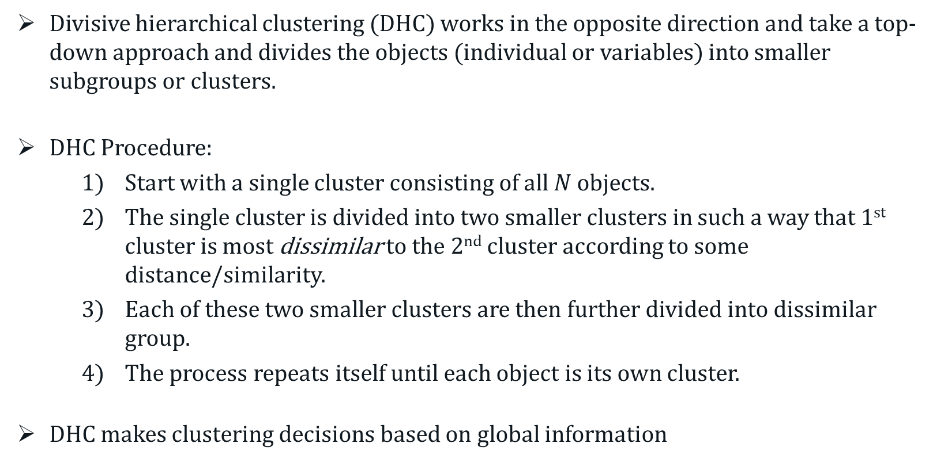
Divisive Hierarchical Clustering
Divisive hierarchical clustering (DHC) works in the opposite direction and take a top-down approach and divides the objects (individual or variables) into smaller subgroups or clusters.
DHC Procedure:
Start with a single cluster consisting of all $N$ objects.
The single cluster is divided into two smaller clusters in such a way that 1st cluster is most dissimilar to the 2nd cluster according to some distance/similarity.
Each of these two smaller clusters are then further divided into dissimilar group.
The process repeats itself until each object is its own cluster.
DHC makes clustering decisions based on global information
Notes:
DHC Not used frequently as it can be quite time consuming. AHC generally provides better results.

Slide 10
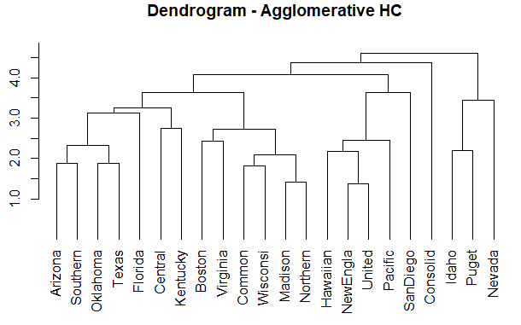
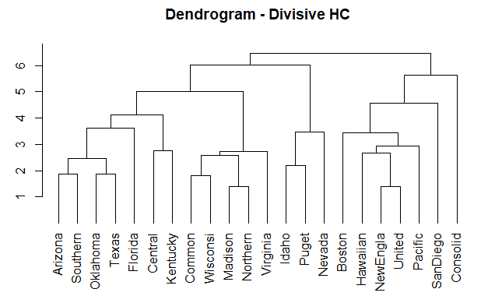
Divisive Hierarchical Clustering
Public Utility Data Revisited
Notes:
DHC Not used frequently as it can be quite time consuming. AHC generally provides better results.

Slide 11
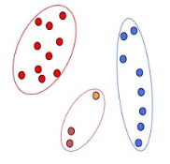
Linkage Methods
The next question is: How do we measure similarity/dissimilarity between clusters of observations?
This is important in the process of merging or dividing clusters.
There are a variety of linkage methods that we can use to do just this.

Slide 12
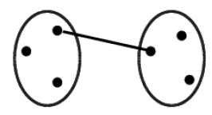
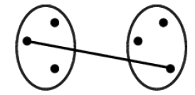
Linkage Methods
The three most commonly used linkage methods are:
Single Linkage (nearest neighbourhood or minimum distance)
Can handle non-elliptical clusters well if the gaps is significant
Sensitive to noise and outliers
Complete Linkage (furthest neighbourhood or maximum distance)
Less sensitive to noise and outliers
Tends to break up larger clusters
Biased toward globular clusters

Slide 13
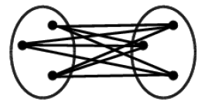
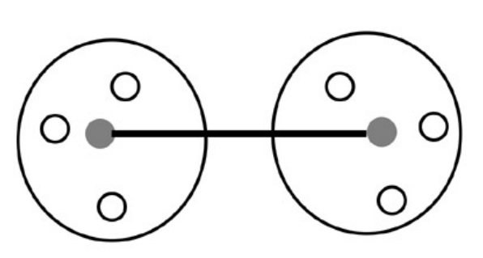
Linkage Methods
Average Linkage (average distance)
A compromise between Single and Complete Linkage
Less sensitive to noise and outliers
Biased toward globular clusters
Centroid Linkage
Ward’s Method.
Similar to Average Linkage
Based on sum of squares of distances instead.

Slide 14
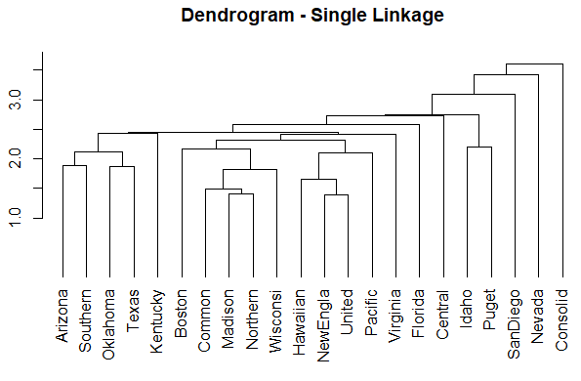
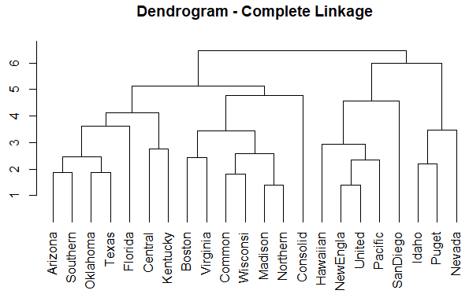
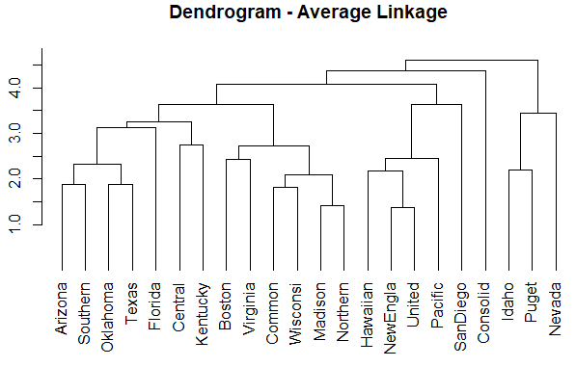
Divisive Hierarchical Clustering
Public Utility Data Revisited
Notes:
DHC Not used frequently as it can be quite time consuming. AHC generally provides better results.

Slide 15
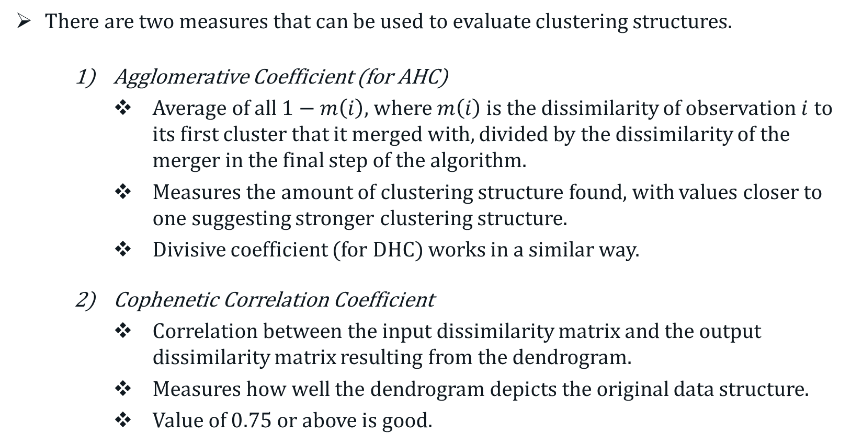
Evaluation of Structures
There are two measures that can be used to evaluate clustering structures.
Agglomerative Coefficient (for AHC)
Average of all $1−m\left(i\right)$, where $m\left(i\right)$ is the dissimilarity of observation $i$ to its first cluster that it merged with, divided by the dissimilarity of the merger in the final step of the algorithm.
Measures the amount of clustering structure found, with values closer to one suggesting stronger clustering structure.
Divisive coefficient (for DHC) works in a similar way.
Cophenetic Correlation Coefficient
Correlation between the input dissimilarity matrix and the output dissimilarity matrix resulting from the dendrogram.
Measures how well the dendrogram depicts the original data structure.
Value of $0.75$ or above is good.

Slide 16
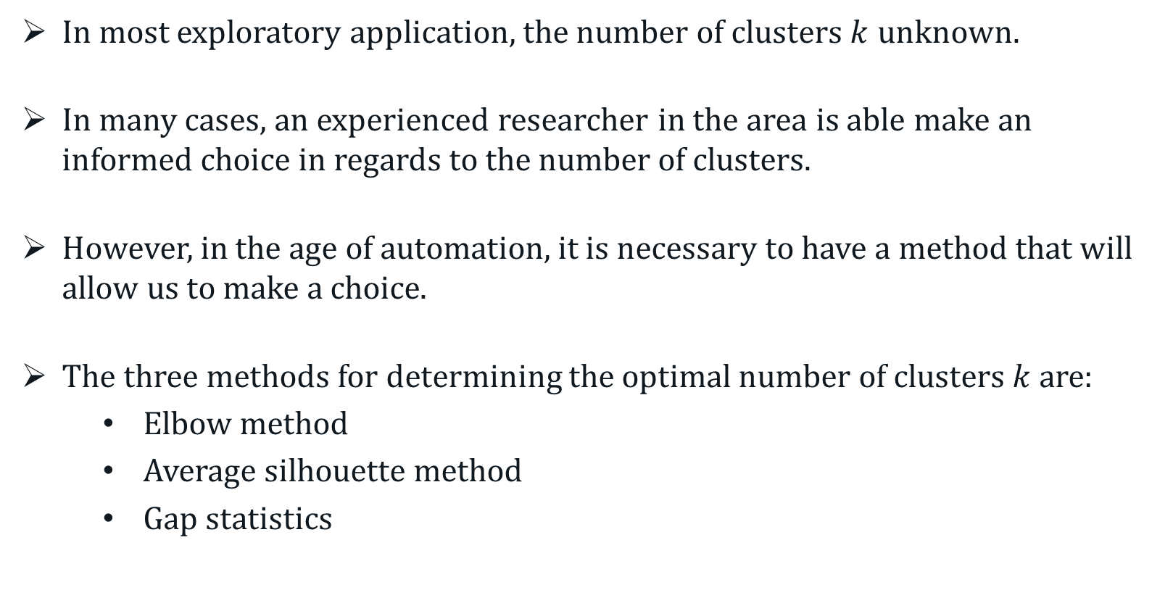
Selection of Final Clusters
In most exploratory application, the number of clusters $k$ unknown.
In many cases, an experienced researcher in the area is able make an informed choice in regards to the number of clusters.
However, in the age of automation, it is necessary to have a method that will allow us to make a choice.
The three methods for determining the optimal number of clusters $k$ are:
Elbow method
Average silhouette method
Gap statistics
Notes:
There is no standard approach to cluster analysis.

Slide 17
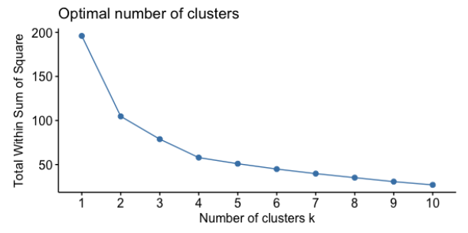
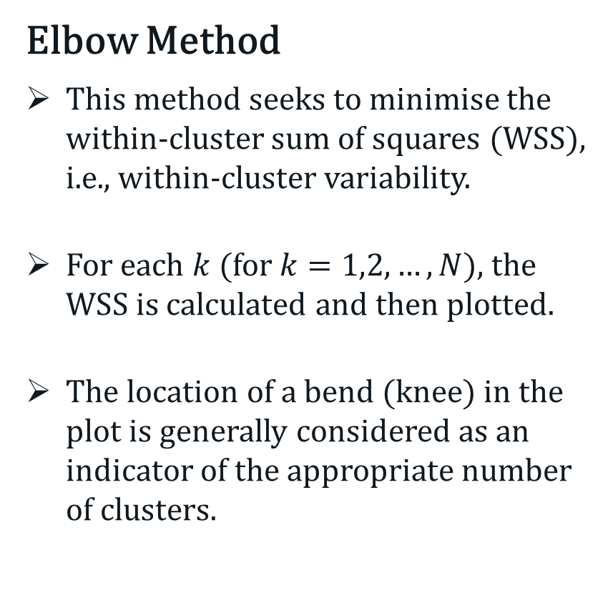
Selection of Final Clusters
Elbow Method
This method seeks to minimise the within-cluster sum of squares (WSS), i.e., within-cluster variability.
For each $k$ (for $k=1,2, …, N$), the WSS is calculated and then plotted.
The location of a bend (knee) in the plot is generally considered as an indicator of the appropriate number of clusters.
Notes:
There is no standard approach to cluster analysis.

Slide 18
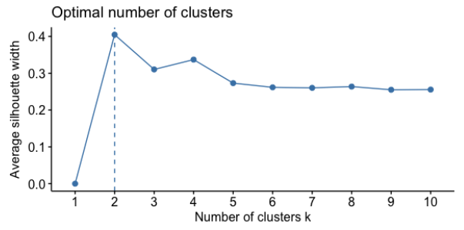
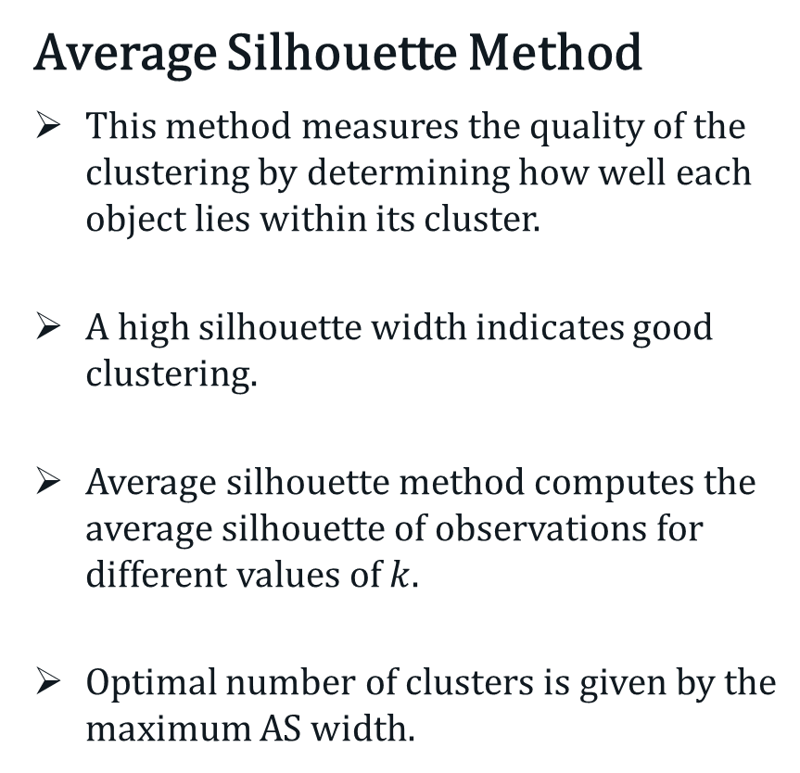
Selection of Final Clusters
Average Silhouette Method
This method measures the quality of the clustering by determining how well each object lies within its cluster.
A high silhouette width indicates good clustering.
Average silhouette method computes the average silhouette of observations for different values of $k$.
Optimal number of clusters is given by the maximum AS width.
Notes:
There is no standard approach to cluster analysis.

Slide 19
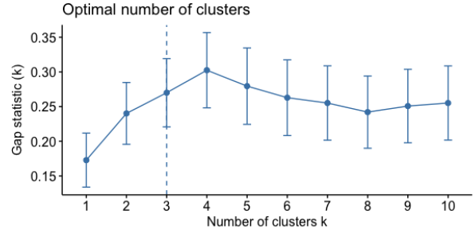
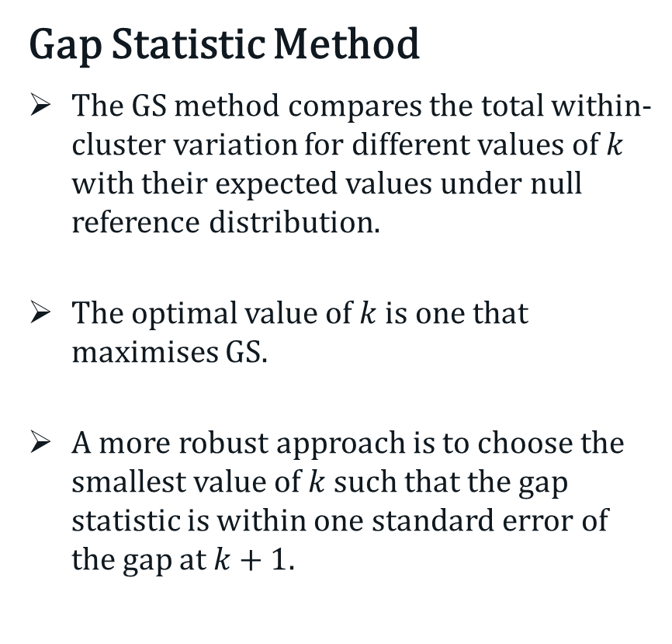
Selection of Final Clusters
Gap Statistic Method
The GS method compares the total within-cluster variation for different values of $k$ with their expected values under null reference distribution.
The optimal value of $k$ is one that maximises GS.
A more robust approach is to choose the smallest value of $k$ such that the gap statistic is within one standard error of the gap at $k+1$.
Notes:
There is no standard approach to cluster analysis.

